Slide 1
Procedural Mesh Generation
Christopher Eicher
Jason Murray
12/6/17

Slide 2

Procedural Mesh Generation
Fun pictures
Code Conventions
Math
Make Money!
Get bought out

Slide 3
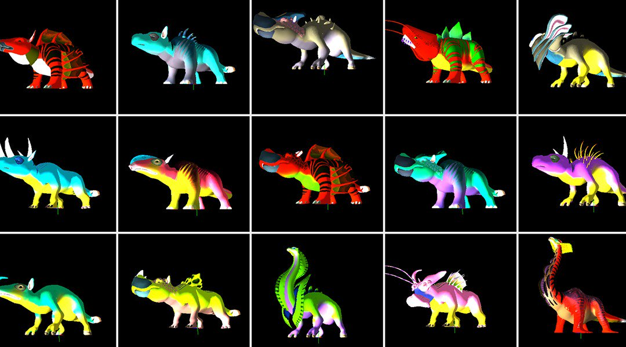
We are good at seeing patterns

Slide 4
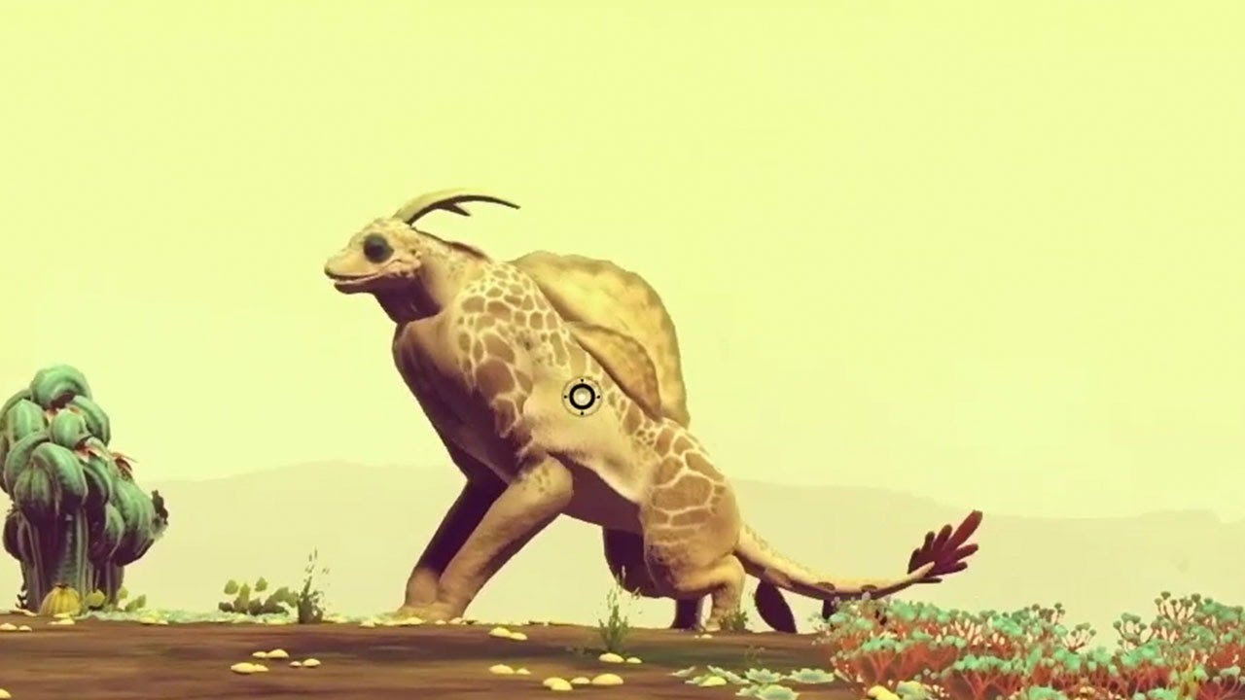
Lego block approach only gets you so far
Bricks are harder to make interesting
Notes:
We want to do more than make content that looks like mashed together parts

Slide 5
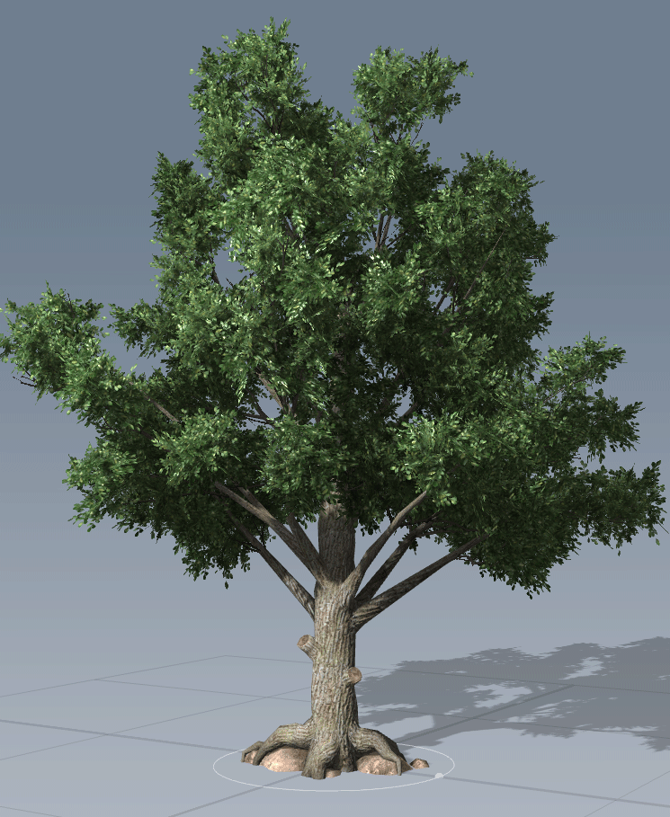
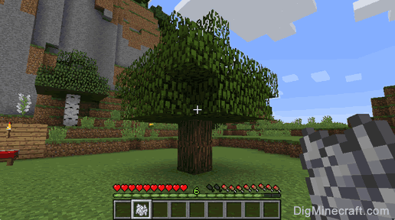
Procedural content generation ≠ blended copy-paste
We can do better
Notes:
We want to do more than make content that looks like mashed together parts

Slide 6
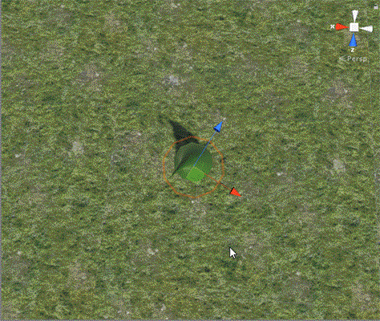
Why Procedural Mesh Generation?
Highly parameterized

Slide 7
Why Procedural Mesh Generation?
Only limited by algorithmic imagination
…as we’ll see later

Slide 8
We can assume some conventions
for (int i = 0; i < iterations; i++)
{
// [0,1] increasing
float t = (float)i / iterations;
// compliment of t, [0,1] decreasing
float tc = 1 - t;
}
Notes:
We want to do more than make content that looks like mashed together parts

Slide 9
Linear Transformation Refresher
vec3 pos = vec3(0, 0, 0);
vec3 dir = vec3(0, 1, 0);
vec3 scale = vec3(1, 1, 1);
/* Translate <- Rotate <- Scale */
mat4x4 trans =
Trans(pos) *
Quaternion.LookAt(dir, vec3(0, 1, 0)) *
Scale(scale);

Slide 10
Unity’s Mesh Structure
std::vector<vec3> verts;
std::vector<int> faces;
std::vector<vec2> uvs;

Slide 11
Simple building blocks facilitate complex composition
Lattices
Bands

Slide 12
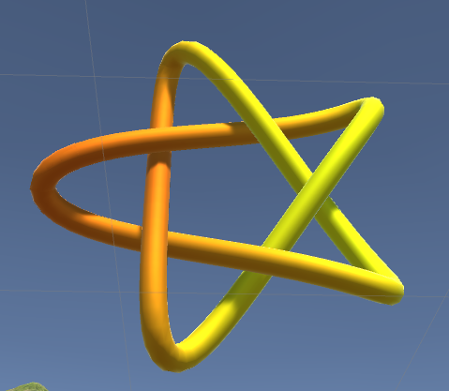
Simple building blocks facilitate complex composition

Slide 13

Lets make rings!
int MakeRing(mat4x4 localToModel, int subdivisions, ...)
{
for (int i = 0; i < subdivisions; i++)
{
float radians = t * 2 * PI;
vec4 vert = vec4(cos(radians), sin(radians), 0, 1);
verts.push_back(localToModel * vert);
uvs.push_back(vec2(t, v));
}
}

Slide 14
Lets make rings!
int MakeRing(mat4x4 localToModel, int subdivisions, ...)
{
for (int i = 0; i < subdivisions; i++)
{
float radians = t * 2 * PI;
vec4 vert = vec4(cos(radians), sin(radians), 0, 1);
verts.push_back(localToModel * vert);
uvs.push_back(vec2(t, v));
}
}

Slide 15
Lets make rings!
int MakeRing(mat4x4 localToModel, int subdivisions, ...)
{
for (int i = 0; i < subdivisions; i++)
{
float radians = t * 2 * PI;
vec4 vert = vec4(cos(radians), sin(radians), 0, 1);
verts.push_back(localToModel * vert);
uvs.push_back(vec2(t, v));
}
}

Slide 16
Lets make rings!
int MakeRing(mat4x4 localToModel, int subdivisions, ...)
{
for (int i = 0; i < subdivisions; i++)
{
float radians = t * 2 * PI;
vec4 vert = vec4(cos(radians), sin(radians), 0, 1);
verts.push_back(localToModel * vert);
uvs.push_back(vec2(t, v));
}
}

Slide 17
Lets make rings!
int MakeRing(mat4x4 localToModel, int subdivisions, ...)
{
for (int i = 0; i < subdivisions; i++)
{
float radians = t * 2 * PI;
vec4 vert = vec4(cos(radians), sin(radians), 0, 1);
verts.push_back(localToModel * vert);
uvs.push_back(vec2(t, v));
}
}

Slide 18
Lets make rings!
int MakeRing(mat4x4 localToModel, int subdivisions, ...)
{
for (int i = 0; i < subdivisions; i++)
{
float radians = t * 2 * PI;
vec4 vert = vec4(cos(radians), sin(radians), 0, 1);
verts.push_back(localToModel * vert);
uvs.push_back(vec2(t, v));
}
}

Slide 19
Lets make rings!
int topEdge = 100;
int bottomEdge = 200;
100 + 1
100
200 + 1
200

Slide 20
Lets make rings!
int AddBand(int topEdge, int bottomEdge, int numVerts) {...}
topEdge + i + 1
topEdge + i
bottomEdge + i + 1
bottomEdge + i

Slide 21

$$t$$
0
1

Slide 22

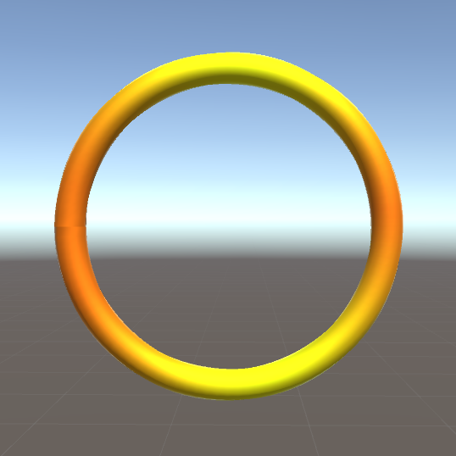

Parameterized curves map $t$
to shapes
$$p\left(t\right)=<x\left(t\right),y\left(t\right),z\left(t\right)>$$
$$d\left(t\right)=<x′\left(t\right),y′\left(t\right),z′\left(t\right)>$$
$$r\left(t\right)=f(t)$$
$$p\left(t\right)=<cos⁡(2πt),sin⁡(2πt), 0>$$
$$d\left(t\right)=<−2π\sin\left(2πt\right),2πcos⁡(2πt),0>$$
$$r\left(t\right)=1$$

Slide 23
Demo

Slide 24
Questions/Comments

